Slide 1

ICCAT Workshop: investigation into bycatch estimation methodologies
Module 3: Model diagnostics and model comparison
Facilitators:
Dr. Beth Babcock
Dr. Ana Adao

Slide 2
Model comparison with Information Criteria (IC)
Within each observation error model group, potential predictor variables are chosen based on the user’s choice of IC (AICc, AIC or BIC)
AICc is a version of AIC corrected for small sample sizes;
BIC is a variant of AIC with stronger penalty for including additional variables to the model with larger sample sizes
The user specifies a most complex and simplest model, and all intermediate models are formulated automatically and considered
All the variables in the simplest and most complex model are interpreted as fixed effects (but random effects can also be included)
The simplest model will usually include year and can optionally include other stratification variables

Slide 3
Model comparison with Information Criteria (IC)
Information criteria can only be used for models that have the exact same response (y) data
Thus, we can use IC to select among variables within a given observation error structure, but not between models with different observation error structures.
The model with the lowest IC is chosen as best within each observation error group. Model selection is done with dredge function in the MuMin library (Barton 2020)

Slide 4
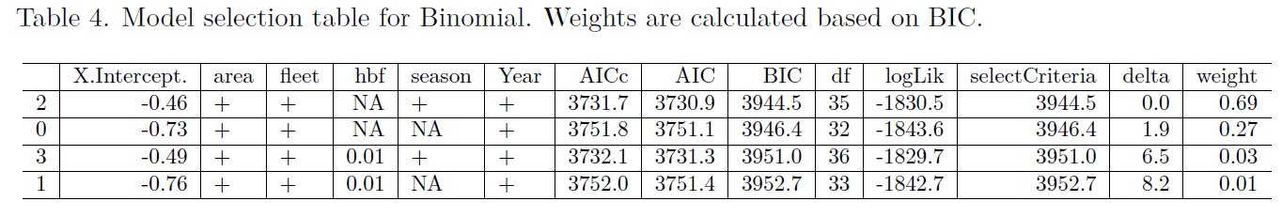
Model comparison with Information Criteria (IC)
The dredge function produces the following table:
This table includes all IC for each model and the model weights, which sum to one and indicate the degree of support for the model (the best model will have the highest weight)

Slide 5
Model diagnostics
For the best model (according to the IC), both ordinary residuals and DHARMa scaled residuals are plotted, and the DHARMa diagnostics are calculated
The DHARMa library uses simulation to generate scaled residuals based on the specified observation error model so that the results are more clearly interpretable than ordinary residuals for non-normal models.
https://cran.r-project.org/web/packages/DHARMa/vignettes/DHARMa.html

Slide 6
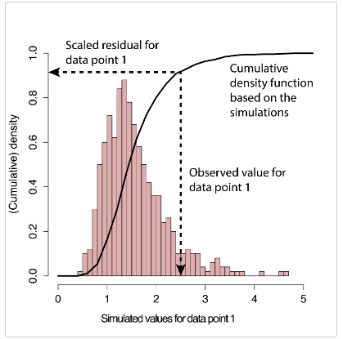
Model diagnostics – DHARMa residuals
The basic steps are:
Simulate new response data from the fitted model for each observation
For each observation, calculate the fraction of simulated data less than the true observation (i.e. quantile residual)

Slide 7
Model diagnostics – DHARMa residuals
A residual of 0 means that all simulated values are larger than the observed value
A residual of 0.5 means half of the simulated values are larger than the observed value
Values of 0.5 are expected, and values should be uniformly distributed between 0 and 1
The residuals should be uniform between 0 and 1

Slide 8
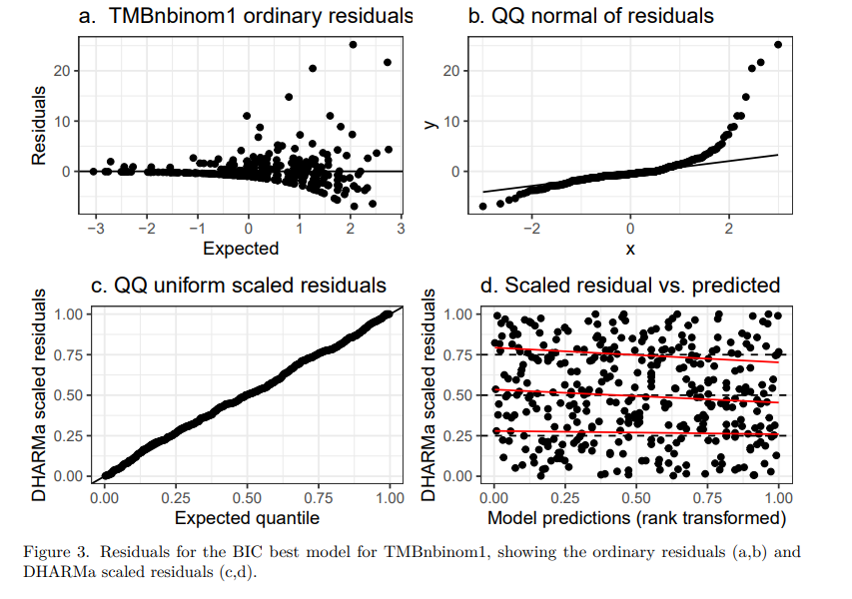
Model diagnostics – DHARMa residuals
Visually misleading
For non-normal models, the DHARMa residuals are a better representation of whether the data are consistent with the assumed distribution
DHARMa residuls demonstrate a good fit to the data

Slide 9
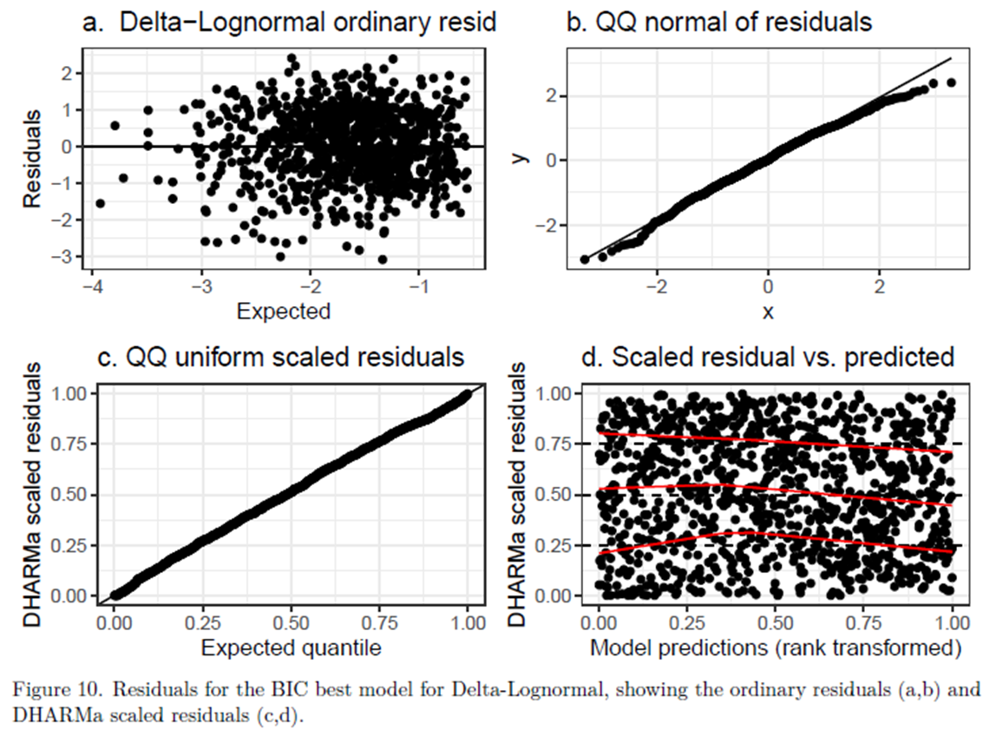
Model diagnostics – DHARMa residuals
For lognormal and gamma models, ordinary residuals and the DHARMa residuals are similar

Slide 10
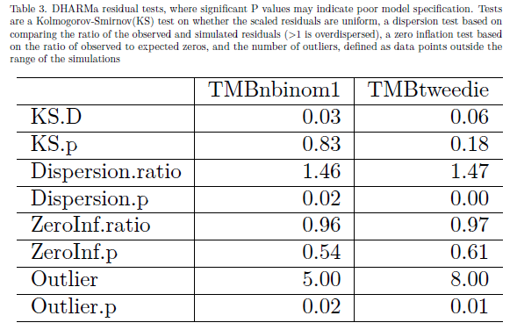
Model diagnostics – DHARMa residuals
The DHARMa library also does some hypothesis tests on whether the residuals are distributed as expected. See manual for details

Slide 11
Model comparison with cross validation
The best candidate model(s) in each observation error group can be compared using 10-fold cross validation to see which observation error model best predicts CPUE
Only observation error models that converged and produced reasonable results with the complete data set are used in cross validation
Cross validation can be used for comparing models that have different response (y) data (i.e., different observation error models)

Slide 12
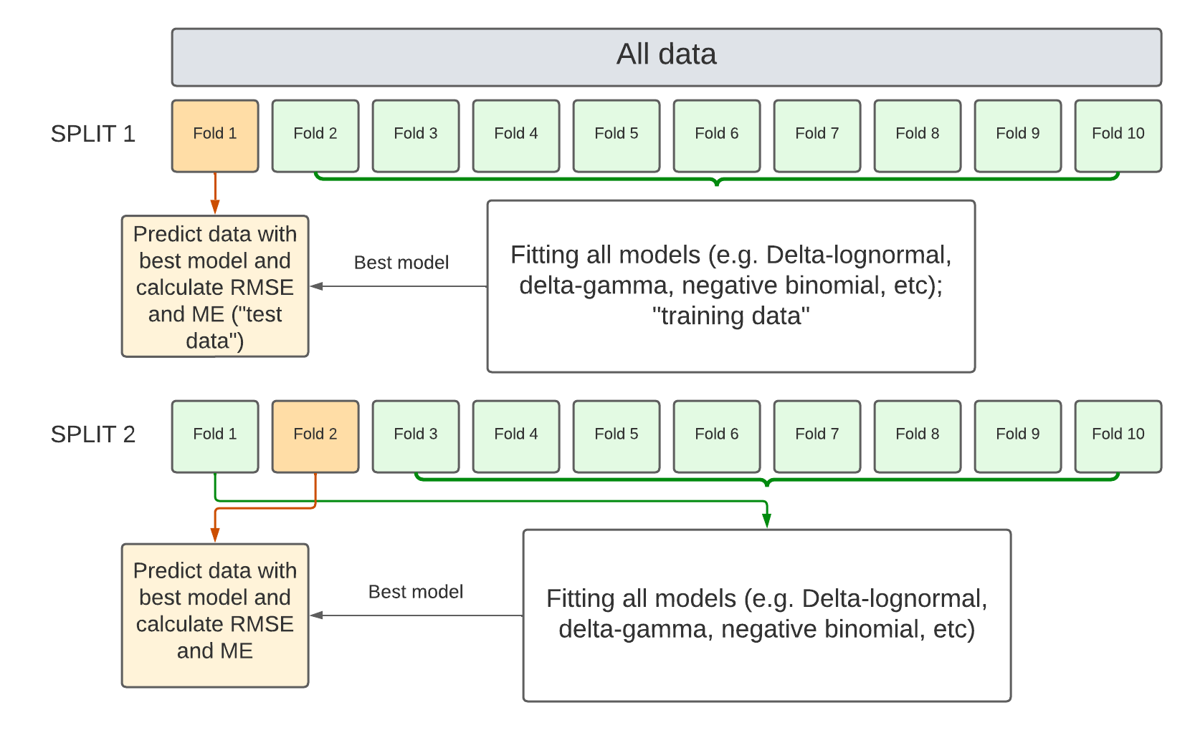
Model comparison with cross validation
The data set is split into 10 folds
Split 1: all models are fitted to folds 2-10 ("training data")
Then, the best model chosen is used to predict CPUE in fold 1 ("test data")
This is repeated consecutively for each of the 10 splits

Slide 13
Model comparison with cross validation
Options:
dredgeCrossValidation = FALSE. Uses best approximating model from IC with complete data for each observation error model
dredgeCrossValidation = TRUE. Use IC to find best model in each fold (may be different by chance).
As a default, use dredgeCrossValidation = FALSE because dredge is slow
Cross validation is only done once. If repeated, may give different results for small data sets.

Slide 14
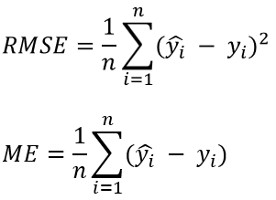
Model comparison with cross validation
n is the number of observed trips, y_{i} is the CPUE data in the left-out tenth fold of the observed data, and y_{i}-hat is the CPUE predicted from the model fitted to the other 9/10th of the observer data
The best model is the one with lowest RMSE (Root Mean Square Error) in the predicted CPUE and the ME (Mean Error) closest to zero

Slide 15
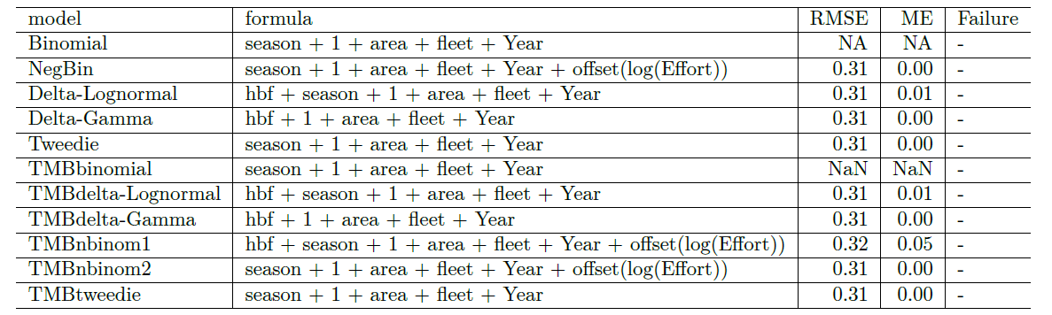
Model comparison with cross validation

Slide 16
References
Barton, Kamil. 2020. MuMIn: Multi-Model Inference. https://CRAN.R-project.org/package=MuMIn.
https://cran.r-project.org/web/packages/DHARMa/vignettes/DHARMa.html

